Slide 1
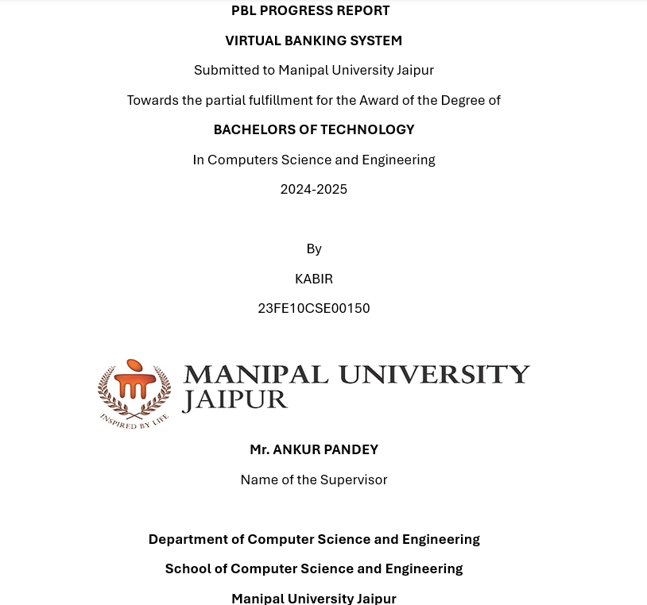

Slide 2
Problem Statement and Objectives to Be Accomplished
Problem Statement
Traditional banking systems, while functional, face major challenges:
1.Centralization Risks: A centralized system becomes a single point of
failure, making it prone to cyberattacks and operational downtime.
2.Transparency Issues: Customers lack the ability to verify the authenticity of transactions independently.
3.Scalability Concerns: As the number of users grows, centralized systems struggle to handle large transactional loads efficiently.
4. Security Breaches: Centralized databases are vulnerable to hacking, fraud, and data tampering.

Slide 3
Objectives
OBJECTIVE 1: Develop a centralized repository for account holder information to ensure consistency and efficiency.
OBJECTIVE 2: Utilize blockchain technology to decentralize transaction records, making them tamper-proof and transparent.
OBJECTIVE3: Implement a secure authentication mechanism for account access to prevent unauthorized use.
OBJECTIVE 4: Create a menu-driven user interface for intuitive interactions.
OBJECTIVE 5: Build a scalable and future-ready banking system capable of handling high transactional volumes securely.

Slide 4
PROGRESS TILL DATE (OBJECTIVES COMPLETED):
1.objective 4: Create a menu-driven user interface for
intuitive interactions.
I have created a partially functional menu-driven user interface for intuitive interactions or as we call it the frontend.
This user interface is created using GTK toolkit
I have used html to convert this banking system into an online website.
I have also used CSS to design the webpage.
To integrate all these components such as the html and CSS part, I have used java script.

Slide 5
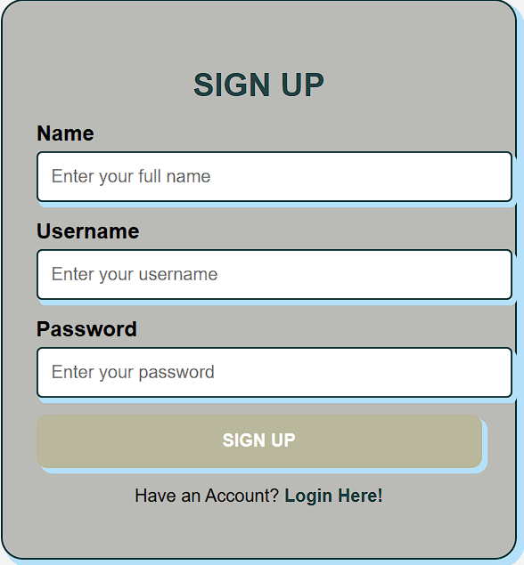
Screenshots of the website:
SIGN-UP PAGE: This page includes the user interface containing a sign- up page.

Slide 6
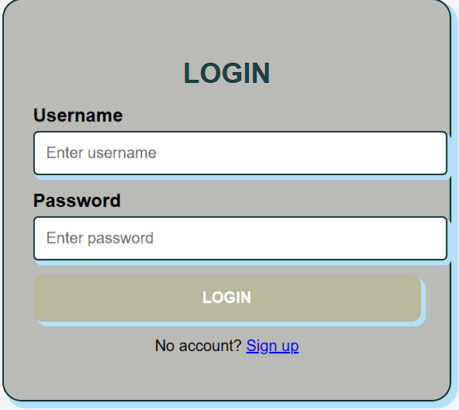
LOGIN PAGE: This page includes the user interface containing the login page and a link to redirect to the sign-up page if you do not have an account.

Slide 7
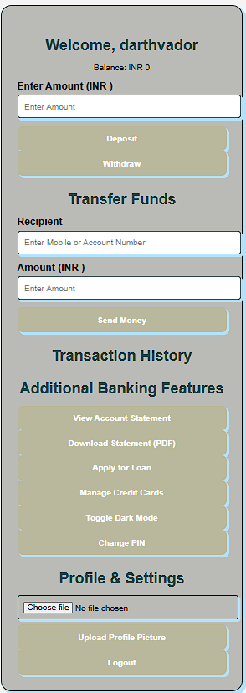
DASHBOARD: This is the main interface of the banking website containing all the necessary features such as depositing/withdrawing money, transaction History, etc.

Slide 8
This project is still in its early stages, as time passes by, the backend for this project will be developed and the original idea of doing transactions through blockchain will be implemented.
THANK YOU

